Slide 1
Goodreads Book Ratings: A Statistical Analysis
DSC 530
Jonathan Lawrence

Slide 2
Hypothesis
A book's rating on Goodreads can be predicted by looking at specific information about previously rated books.

Slide 3
Setup
Dataset: 'book_data.csv’
Acquired from: https://www.kaggle.com/meetnaren/goodreads-best-books

Slide 4
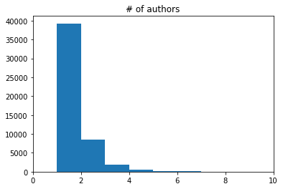
Variable 1: Number of Authors
As expected, most books have only one author. There are a few outliers at 6+ authors, but we can assume they are collections of short stories or smaller, published works sold together as a set.

Slide 5
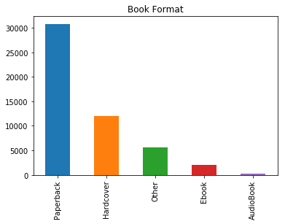
Variable 2: Book Format
Most books with reviews are paperbacks. This could be due to publishing costs of hardcovers and/or technology required to access digital media. The outliers in this case would be the 'Other' category. It likely contains some books that would more closely match one of our primary formats, but the person who added these books in the data wrote a vauge description of the format.

Slide 6
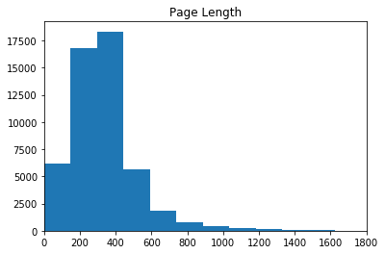
Variable 3: Page Length
A majority of books represented contain anywhere from 200-400 pages. There are some outliers with over 1000, but they are very infrequent.

Slide 7
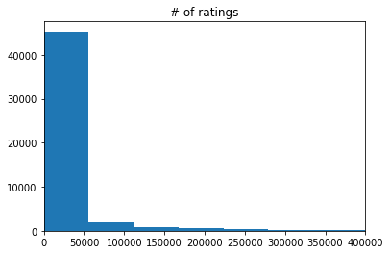
Variable 4: Number of Ratings
Most of the books have 0-50,000 ratings. Very few have more than 50,000 so we can consider those as outliers.

Slide 8
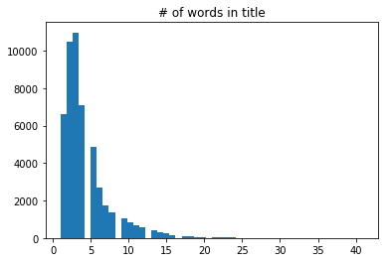
Variable 5: Number of Words in Title
Most books have anywhere from 2-5 words. Very few book titles contain more than 10 words, so we can assume those outliers are potentially parts of collections or short stories.

Slide 9
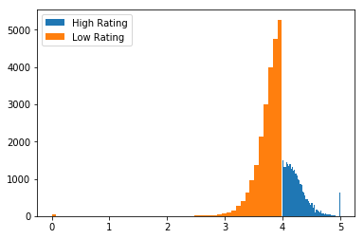
Probability Mass Function
Based on this figure, there are more books rated less than 4.0 than there are rated higher than 4.0.

Slide 10
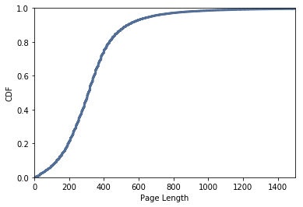
Cumulative Distribution Function
It appears that approximately 90% of books have 600 pages or less. The graph is mostly smooth from page length 0-600, indicating that there is not a prefered page length in that range. Less than 5% of books are over 800 pages, and likewise less than 5% are under 100 pages.

Slide 11
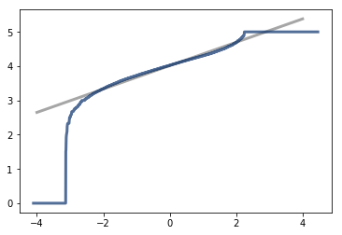
Analytical Distribution
My model (gray) and the data (blue) are very similar, but there is a slight difference at the extremes. Really low ratings are lower than the model predicted, and really high ratings are slightly higher than it predicted.

Slide 12
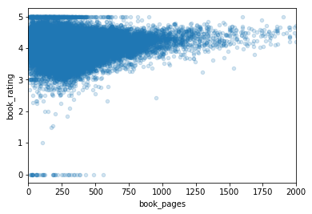
Analytical Distribution
From the first graph, it appears that a book's rating has a weak positive correlation with the page length.
From this, we can say that a book's rating is slightly affected by the page length.

Slide 13
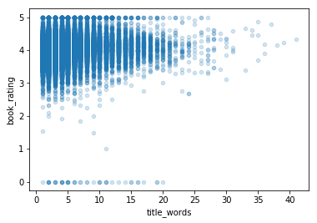
Analytical Distribution
From the second graph, it seems that a book's rating has a weak positive correlation with the number of words in the title.
From this, we can say that a book's rating is slightly affected by the number of words in the title.

Slide 14
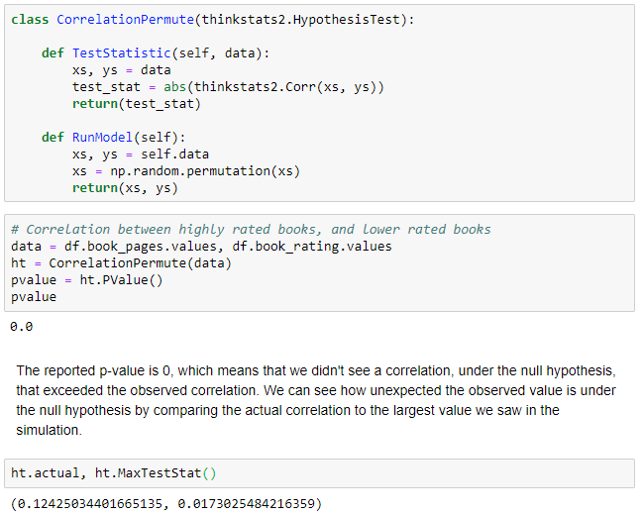
Hypothesis Test
The reported p-value is 0, which means that we didn't see a correlation, under the null hypothesis, that exceeded the observed correlation. We can see how unexpected the observed value is under the null hypothesis by comparing the actual correlation to the largest value we saw in the simulation.

Slide 15
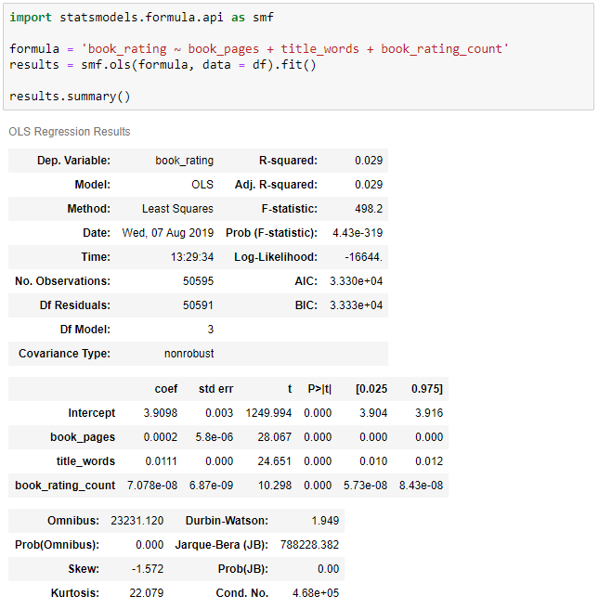
Regression Analysis (part 1/2)
Using the statsmodels module, we can see the OLS Regression results as it relates to the effects of different independent variables as it relates to a book’s rating. I’ve chosen to look at page length, number of words in the title, and the number of ratings a book receives.

Slide 16
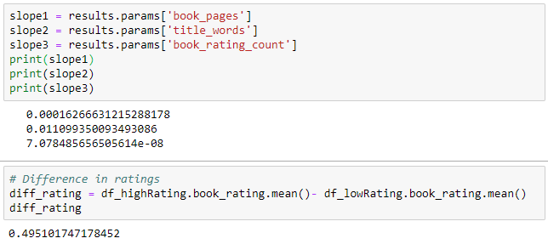
Regression Analysis (part 2/2)
From these numbers, we can conclude that the difference in ratings can be partly explained by the difference in the page length, number of words in the title, and the number of ratings a book receives. The largest factor of the three is the number of words in the title.

